Slide 1

Sprocket Central Pty Ltd
Data analytics approach
[Division Name] - [Engagement Manager], [Senior Consultant], [Junior Consultant]

Slide 2
Agenda
Introduction
Data Exploration
Model Development
Interpretation

Slide 3
Introduction
Analysis of the dataset for Targeting the new customers
The analysis will be done based on following factors:-
Based on Gender.
Based on wealth segments.
Based on job industries.
Based on whether they own a car or not.
Getting their Age through their DOB and then split them into categories to analyze.

Slide 4
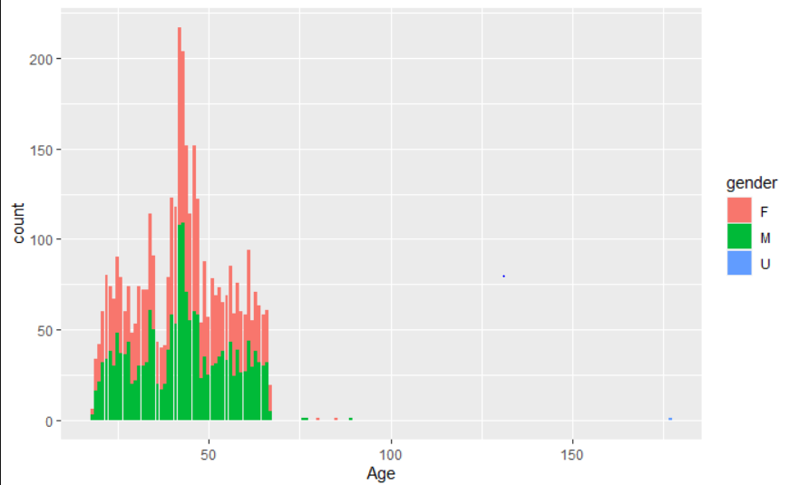
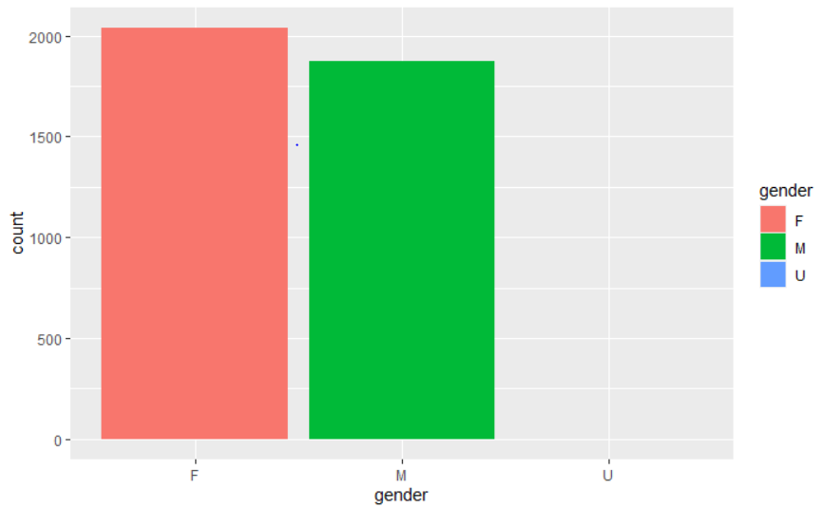
Data Exploration
As per the figure, it can be observed that younger males have purchased bikes and later on females have more contribution. The younger group is more likely to purchase and hence they should be considered while forming a plan.
As we can observe that the females contribute more to the business than males. They should target more females customers to increase the business.

Slide 5
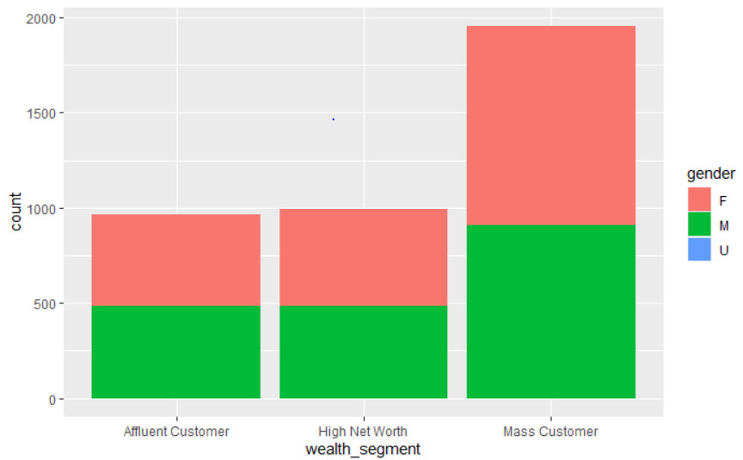
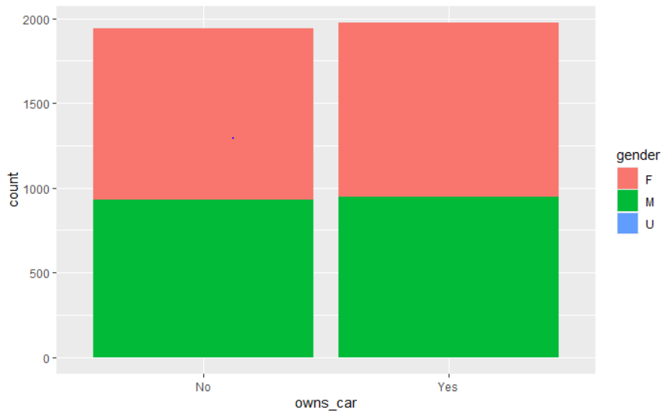
Data Exploration
According to the graph the mass customer wealth segment has almost twice the contribution than others. High net worth beats affluent customer with just a little margin. Mass customers should be considered to increase the sales.
As per the bar graph it can be observed that customers who owns the car has a slight more possibility to purchase. But it can be concluded that they should target both the categories.

Slide 6
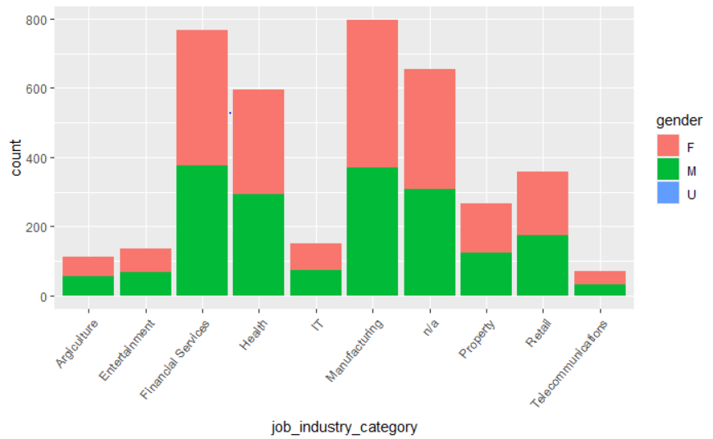
Model Development
For the model development, we should consider the job fields of the customer to particularly understand the needs of the particular sector and accordingly form plans to increase the business.
As per the graph it can concluded that the Manufacturing industry has highest contribution to the business. Additionally they should try to get the rough idea for n/a industry as it is the third highest.
Accordingly ideas must be implemented to increase sales in the other fields as well.

Slide 7
Interpretation
As per the exploratory analysis, it can be concluded that male for the younger ages, and for later females have high potential to be a customer.
Currently in the wealth segment the mass customer have a higher contribution then the rest of the customers.
Apparently, there is a slight difference the customer who owns a car has higher chance to buy a bike.
As per the model development it can be concluded that a person in manufacturing job category has higher chances to purchase a bike and hence they should be targeted.

